Slide 1

ORB
Online Retail Bot

Slide 2
What is ORB?
The Online Retail Bot (ORB) is an application written in Python with the intentions of being able to checkout online items from various websites much faster than a human ever could.
ORB uses Selenium and Chrome Webdriver to read HTML elements as well as interact with the page. Because of this you are less likely to be banned by bot protection that is present on many sites.

Slide 3
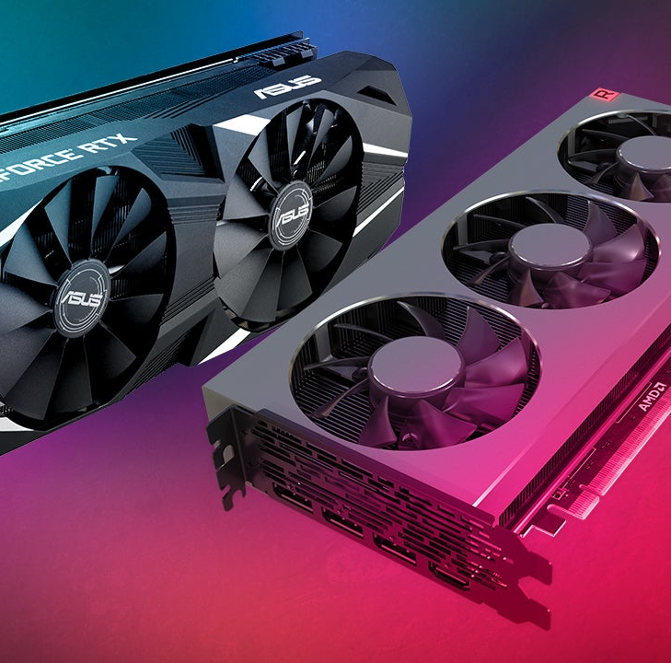
Target Audience
Currently ORB only support one website, Bestbuy.com. Because of this the target audience will be any user wishing to purchase highly limited electronics on the day of release. Such as a PlayStation 5 or a graphics cards. Both can be extremely hard to obtain for the average customer due to high demand (cryptocurrency mining)and other users botting as well.

Slide 4
Target Audience (continued)
Now you may be saying, why not just buy a bot from someone else? Well the main reason behind this is that functioning bots that do a similar function and service to ORB can run you upwards of $300-400 retail. And in some cases $3000 + on the resell market (yes people resell bots made for reselling…). Not only are these bots extremely expensive but they are also highly limited. Because of this most users will have to use a bot in order to… purchase a bot.
ORB will be FREE to all users, but non-invasive advertisements may be used in the future to cover the cost of development and updates

Slide 5
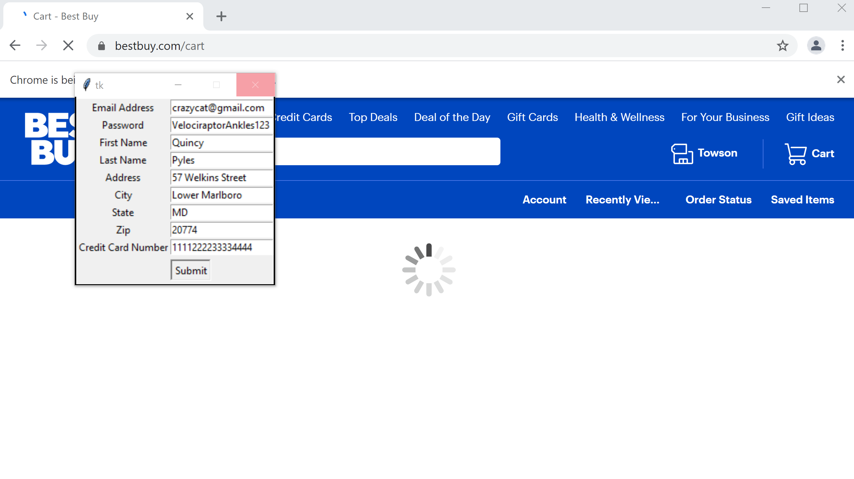
ORB in Action

Slide 6
Incomplete Features
At the time of writing, ORB has 2 issues.
1. I have not yet been able to find a solution to allow users to input the URL for the product they wish to purchase through the GUI (graphical user interface). Currently the only way to input the URL is through the code in Python. The reason behind this is a troublesome .get statement not accepting variables. But possible solutions are being thought of.
2. Selecting the state during the checkout process. It theoretically works but not the way it should or that I would want it to. The reason behind this is that there is no HTML specific ID for the states on the page. Because of this I was forced to use a while Loop and increment it, clicking downwards until it reaches the number equal to the states position in the dropdown menu.

Slide 7
Future Updates
There are several features that I wish to add to ORB:
Proxy support – Proxy support will allow the user to run multiple task at once on the same site. The reason this is not possible at the moment is due to the fact a majority of online retailers are aware of botting. One of the features to prevent botting is not allowing multiple attempts from the same IP address. Adding proxy support will reduce the risk of being banned from these sites as well as increasing the likelihood of multiple checkouts.
Add other sites to ORB’s roster – ORB was originally designed with the purpose of being a sneaker bot. But I do not believe this would be the best course of action anymore. The sneaker/fashion market has become oversaturated with competition from other bots and bot makers who’ve had much more time to learn the in’s and out’s of the trade. As well sites have had ample time to figure out to prevent them, such as Supremes “Pooky”- a script that generates cookies and uses those cookies to checkout, which has yet to be figured out by current botters. Because of this ORB will be sticking to electronic retailers such as Bestbuy with hopes of expanding to other retail giants such as Walmart, Target, NewEgg, and others.
UI Update – I would also like to update ORB’s GUI to make it more professional, “pretty”, and easy to use

Slide 8
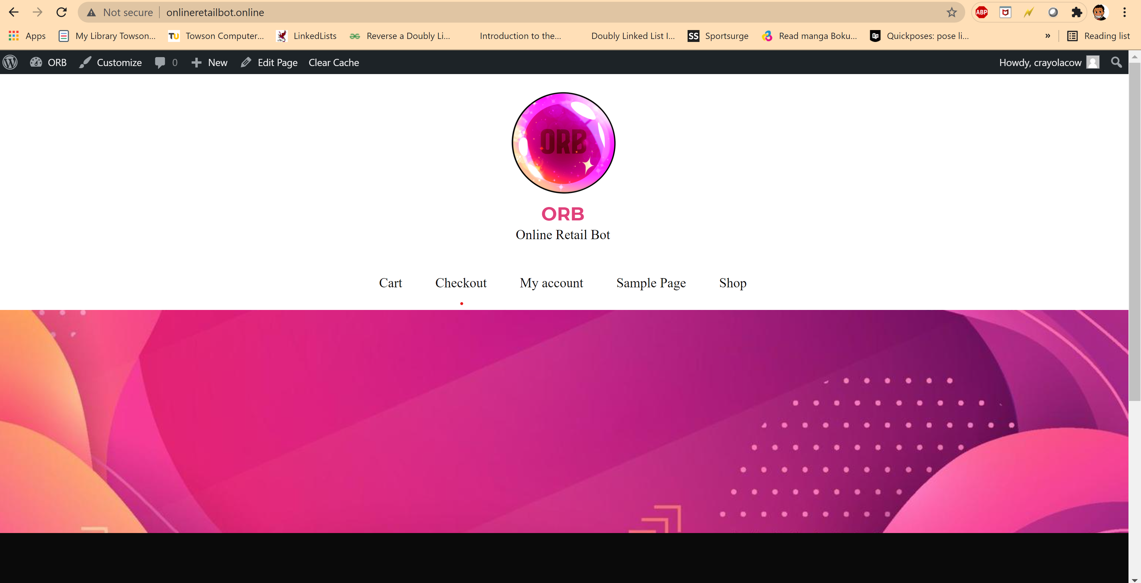
ORB website

Slide 9
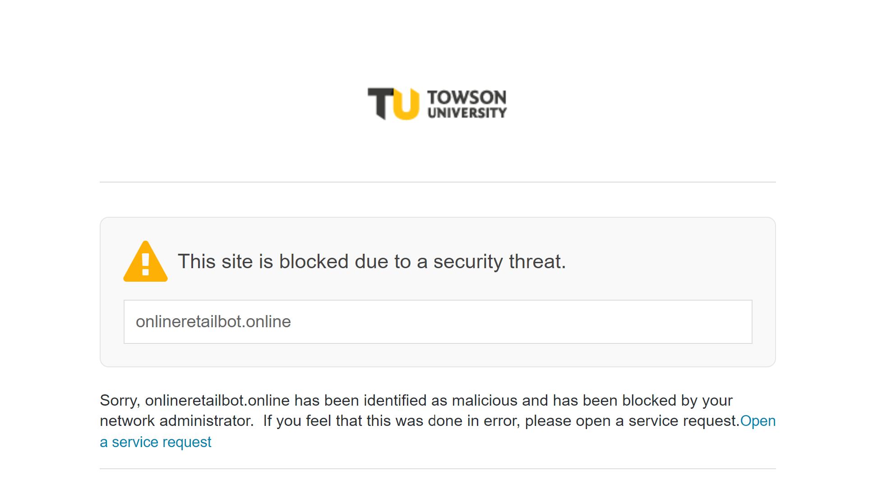
Why doesn’t Towson want me to be great?

Slide 10
Thank You For Watching!

